Slide 1
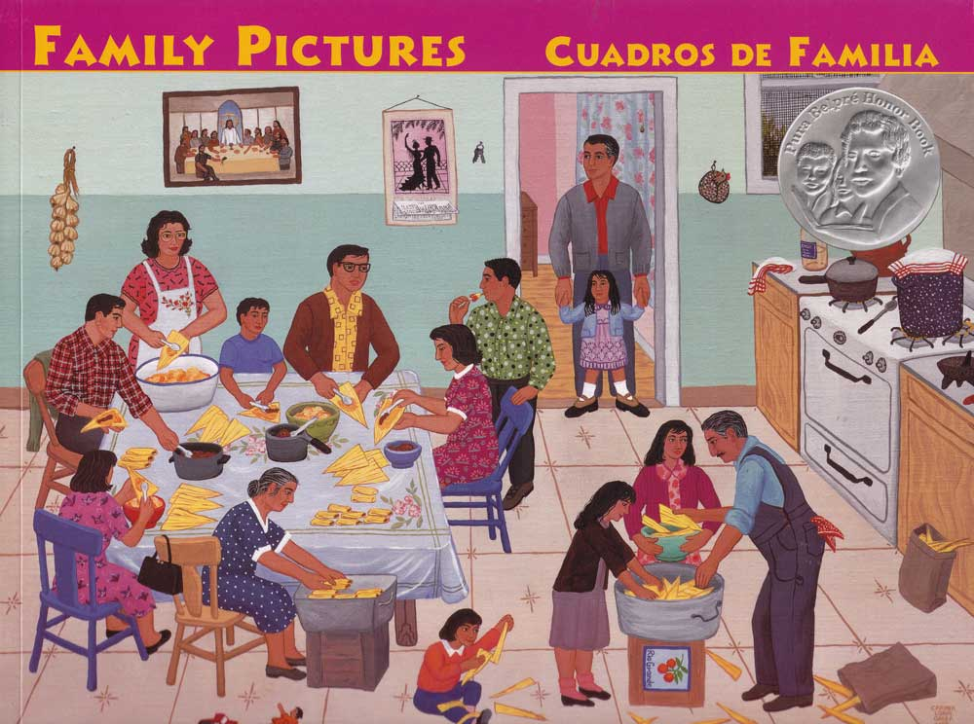
Kindergarten- Unit 5
Text Talk
Old Wire Elementary School-Rogers, Arkansas

Slide 2
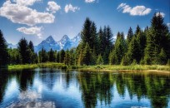
scene the setting and all that is in it
The students were amazed at the beautiful mountain scene.

Slide 3
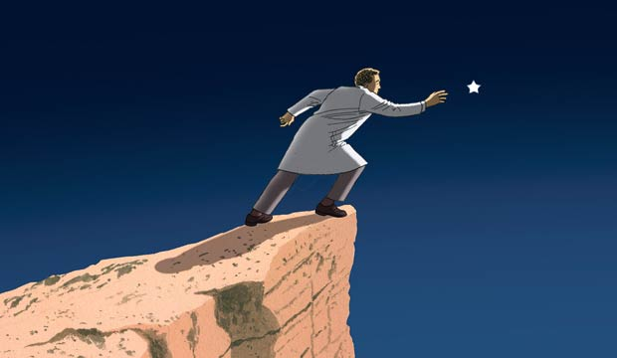
beyond outside of an area
The star was beyond the man’s reach.

Slide 4
inspired to make someone work hard or create something
This poster inspired men to join the military.

Slide 5
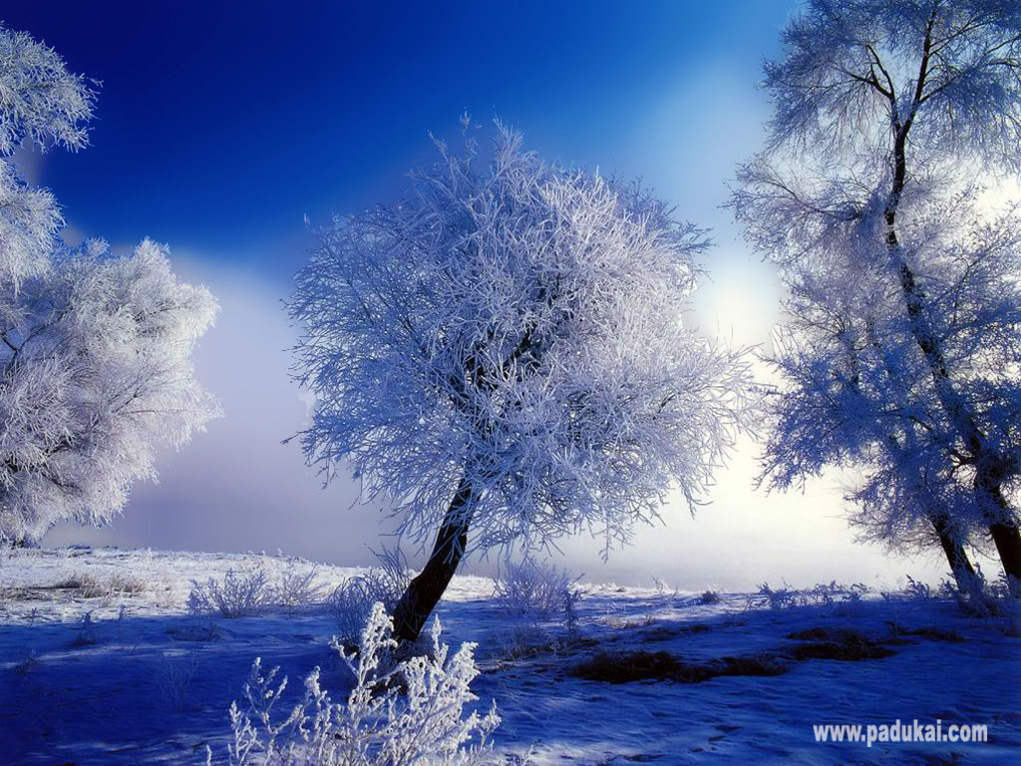
Which picture shows scene?

Slide 6
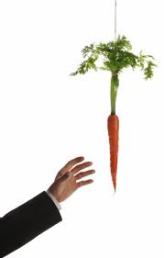
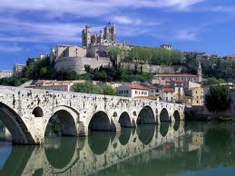
Which picture shows beyond?

Slide 7
Which picture shows inspired?

Slide 8
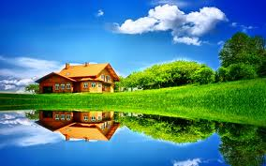
Which word goes with this picture: scene, beyond, or inspired?

Slide 9
Which word goes with this picture: scene, beyond, or inspired?

Slide 10
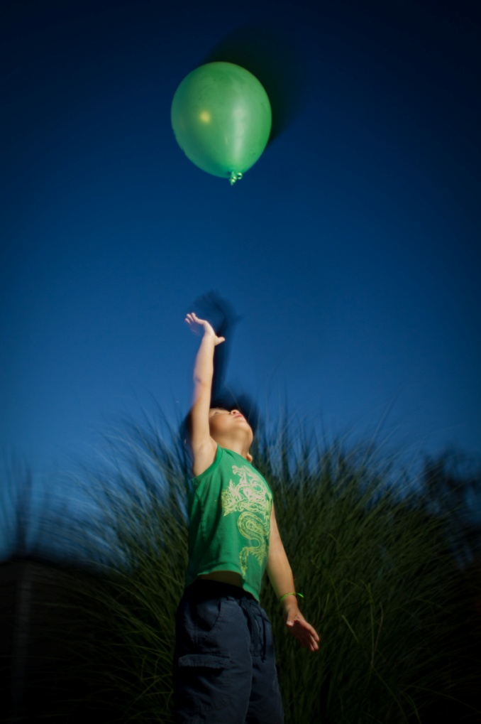
Which word goes with this picture: scene, beyond, or inspired?

